Slide 1
Steam Distillation
06052
David Chung

Slide 2
Basics
Distillation
Extracting a specific substance from a liquid compound
Benefits
Quality control
Control temperature and steam
Wide application
Works for most substances immiscible with water, but mostly used for extracting essential oils
Works for high boiling oils
Uses
Extracting essential oils for perfumes
Chemical labs for separating substances
Notes:
Immiscible means that it doesn’t mix well with water, and something that is not very volatile means that it does not change states easily, like becoming a vapor

Slide 3
Goal of Steam distillation
Utilize low boiling point property of immiscible mixtures
Damage is minimized because boiling temperature is reduced
Vapor pressure contributes independently
Total vapor pressure is sum of the two immiscible liquid’s vapor pressures
Used to separate oils that are immiscible to water from compounds
Notes:
Immiscible mixtures have a low boiling point, one that is lower than its constituents because the vapor pressure of its parts contribute independentaly to the toal vapor pressure. Because each part now contributes to obtaining a certain vapor pressure required to boil, the mixture would have a lower boiling point. This wouldalso help

Slide 4
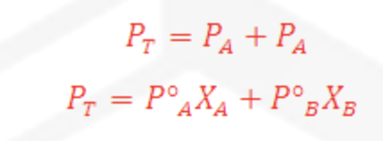
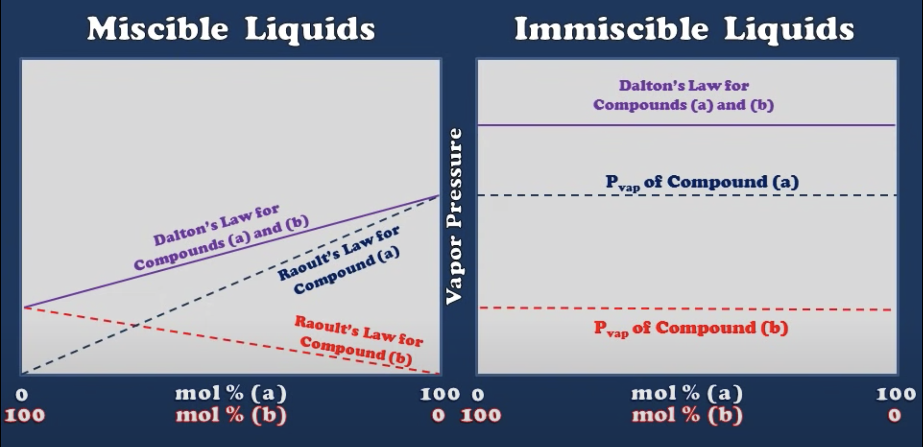
Miscible vs Immiscible
Immiscible liquids that do not form a homogenous mixture

Slide 5
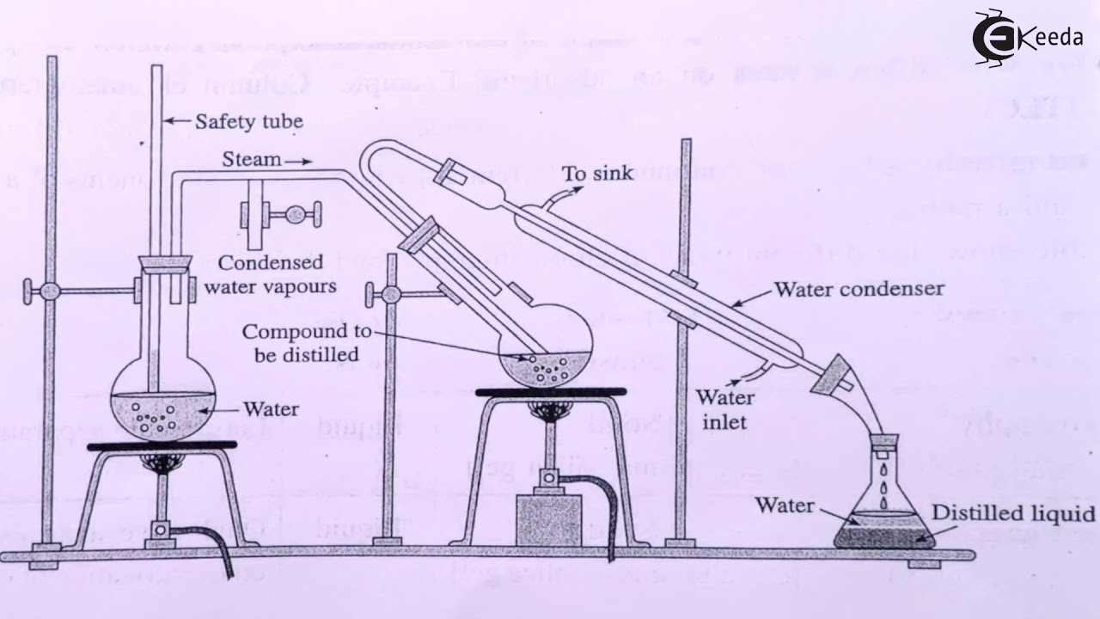
Equipment

Slide 6
Inputs
Outputs
Heat to boil the water
Heat to boil the mixture
Water to create steam
Compound to distill
Mixture of water and immiscible oil
Nonvolatile remainder of compound

Slide 7
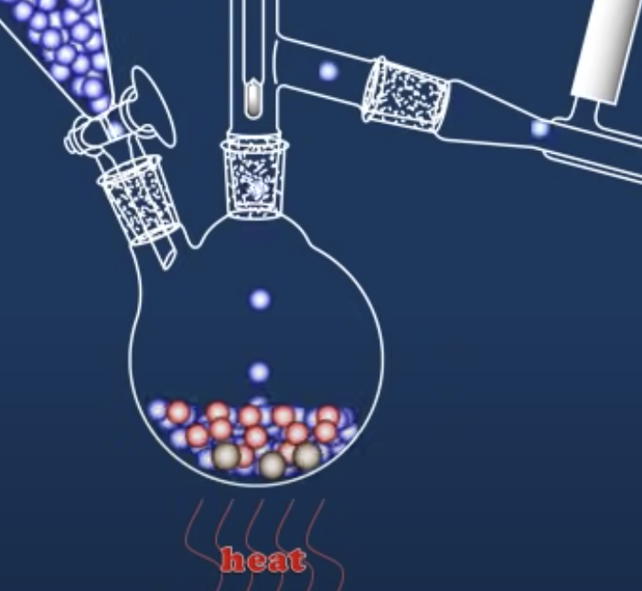
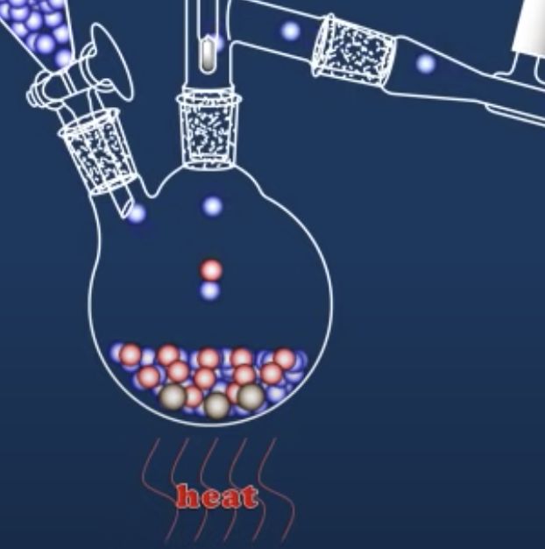
Process
Steam enters compound, increasing pressure
Steam is distilled first because it is the most volatile
Immiscible oil distills next with steam as its boiling point has been decreased as the overall vapor pressure has increased

Slide 8
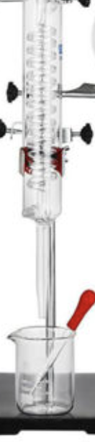
Process cont.
Immiscible oil is condensed
Cold water enters into condenser
Result is mixture of water and immiscible oil which can be easily separated

Slide 9
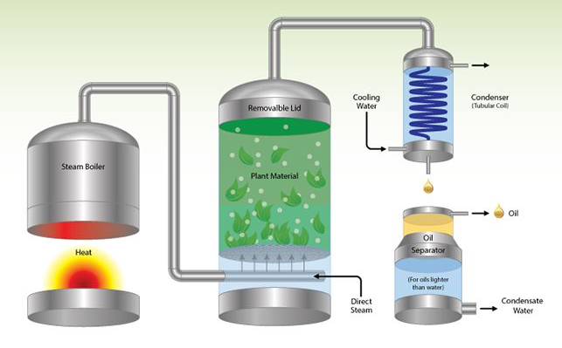
Essential Oils Example

Slide 10
Sources
https://www.leaf.tv/articles/advantages-disadvantages-of-steam-distillation/
https://www.sciencedirect.com/topics/agricultural-and-biological-sciences/steam-distillation - :~:text=Steam distillation is used for,gas to extract the oils.
https://www.thoughtco.com/definition-of-steam-distillation-605690
https://www.youtube.com/watch?v=7g4e3dhtgjI&ab_channel=ChemSurvival
https://www.youtube.com/watch?v=OVQC-6qIq-Y&ab_channel=TazekaAromatherapy
https://www.jove.com/science-education/11204/steam-distillation

